Slide 1



Predicting Patients' Health by Understanding the Severity of Asthma Symptoms
CPSC 5305 Introduction to Data Science
Keerthana Senthil Raja
Dharanipriya Ravindran

Slide 2
Problem Statement
Asthma remains a significant health challenge despite existing treatments.
Symptoms and severity are highly variable, influenced by demographic, medical, and lifestyle factors.
Current predictive models lack precision and personalization for effective management.
This project aims to improve predictive accuracy by analyzing a comprehensive dataset using advanced statistical and machine learning techniques.

Slide 3
Key Dataset Features
Demographic Information:
Age & Sex: Examined for their impact on asthma variability.
Clinical Measurements:
Height, Weight, BMI: Key health indicators linked to asthma risk.
PEFR (Peak Expiratory Flow Rate):
Average: Measures lung function.
Standard Deviation: Indicates lung function variability
Environmental Factors:
Mean Temperature: Explored for its effects on asthma during seasonal changes.
Mean Humidity: High levels can worsen asthma symptoms.
Air Quality Index (AQI): Strongly tied to respiratory health; poor AQI linked to increased asthma attacks.

Slide 4

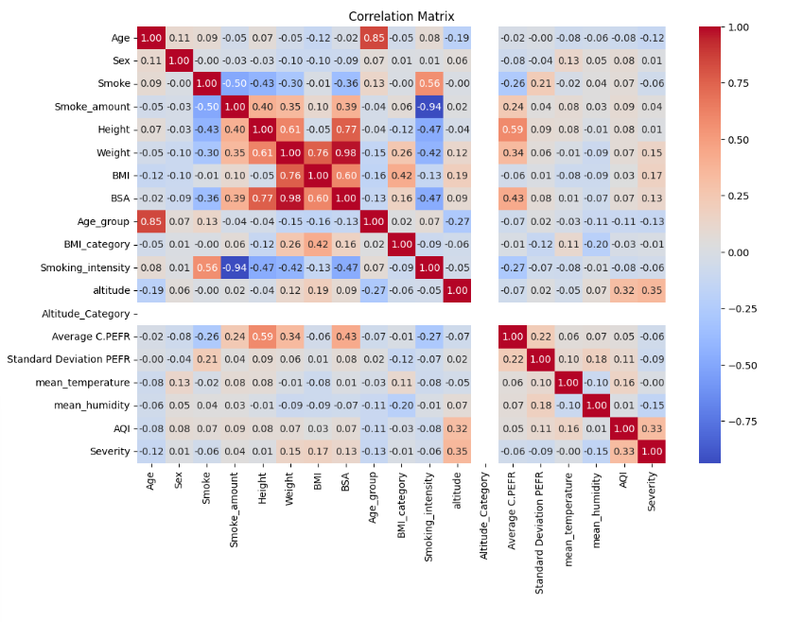
Exploratory Data Analysis (EDA)
PEFR Distribution:
Display a histogram or box plot.
Highlight variations across age groups and smoking status.
Correlation Heatmap:
Show correlation between BMI, AQI, and asthma severity.
Emphasize key strong correlations.
Trend Analysis:
Use a line graph or scatter plot.
Illustrate asthma severity trends in relation to environmental changes like temperature and AQI.

Slide 5
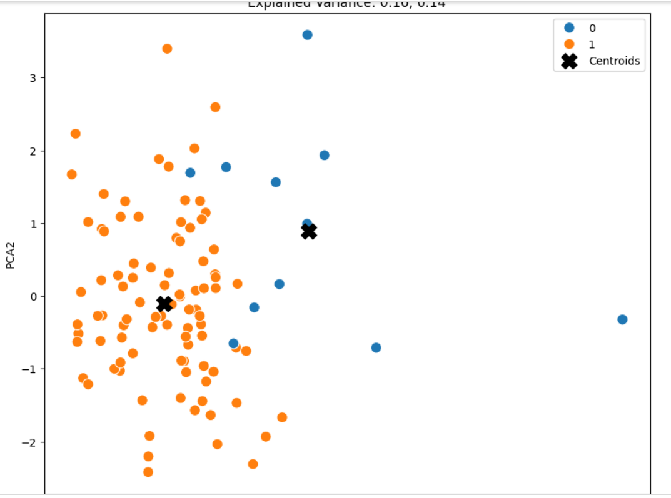
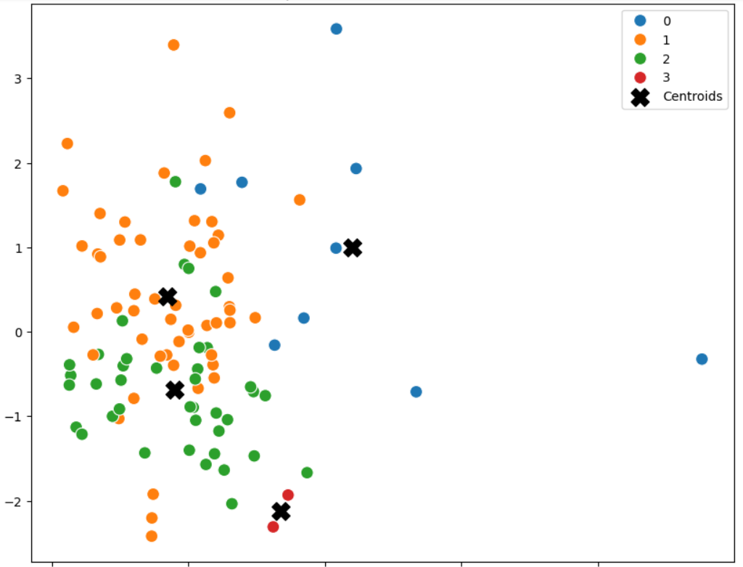
Modeling and Analysis
Clustering Analysis:
Objective: Improve model accuracy by using clustering techniques to segment data into uniform groups.
K Value Selection:
Applied the Elbow method and Silhouette scores to identify the best number of clusters, selecting K=2 and K=3.
Visuals: Displayed Elbow curve and Silhouette plots to illustrate cluster validity
Clustering Implementation:
Applied K-Means clustering for K=2 and Hierarchical clustering for K=3 to segment the dataset.
Developed separate regression models for each cluster to tailor the predictions based on the unique characteristics of each group.

Slide 6
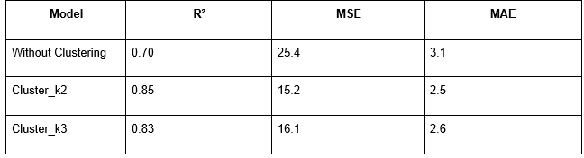
Modeling and Analysis
Regression Modeling:
Objective: Predict asthma severity using environmental, demographic, and clinical data.
Methodology: Started with a baseline linear regression model to evaluate initial predictive ability.
Key Findings: The baseline model revealed the need for advanced segmentation to fully capture interactions between variables

Slide 7
Challenges and Future Directions
Challenges:
Data Quality: Missing values and variability in environmental data.
Modeling: Baseline regression lacked complexity; cluster size imbalance affected generalizability.
Computational Complexity: Hierarchical clustering was resource-intensive.
Future Directions:
Data Expansion: Add variables like pollen count and expand geographically.
Advanced Models: Explore non-linear models like random forests or neural networks.
Applications: Develop real-time prediction tools and validate models in clinical settings.

